Slide 1
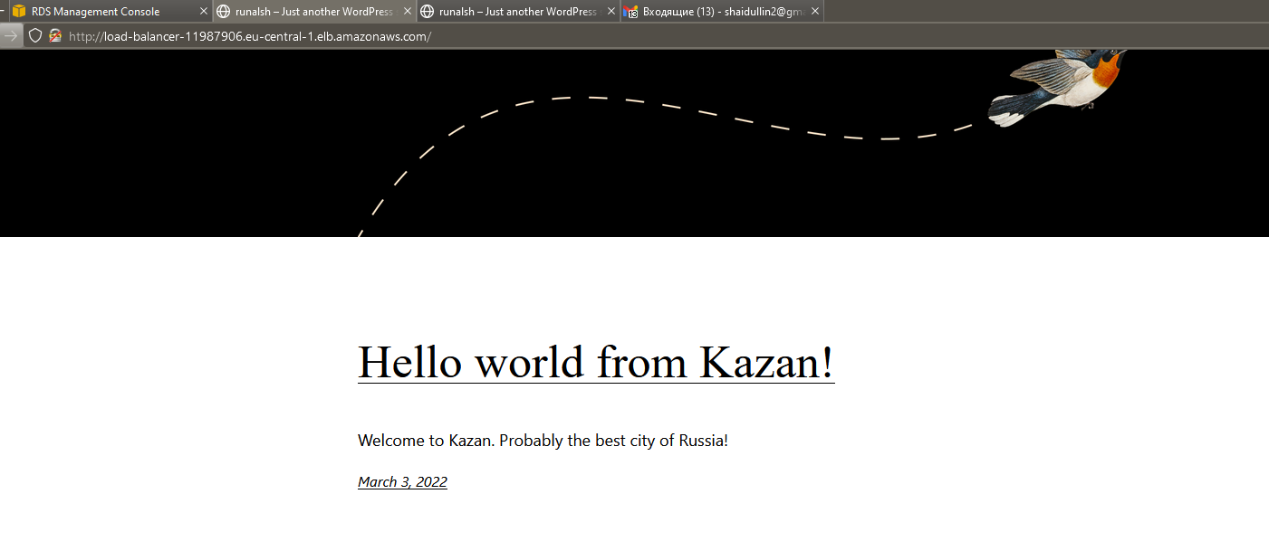
Hello from AWS
Telegram @ilnursh or @runalsh
For EPAM 03.03.2022

Slide 2


Check terraform state on S3
changed
modify
Not changed
Monitoring
Health status
LB
ASG
Scaling
or
Terminate

Slide 3
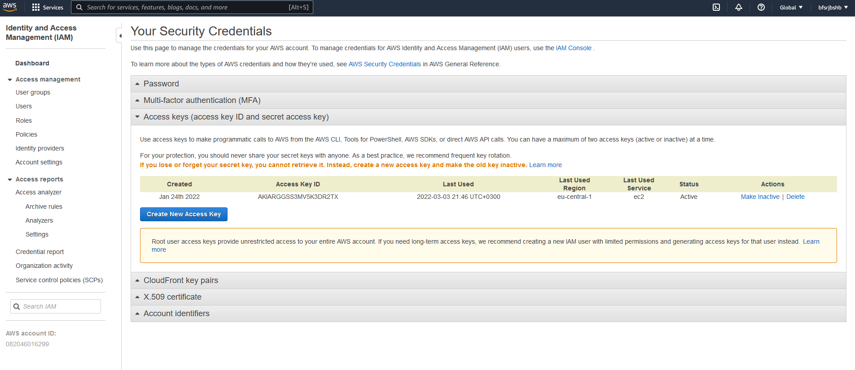
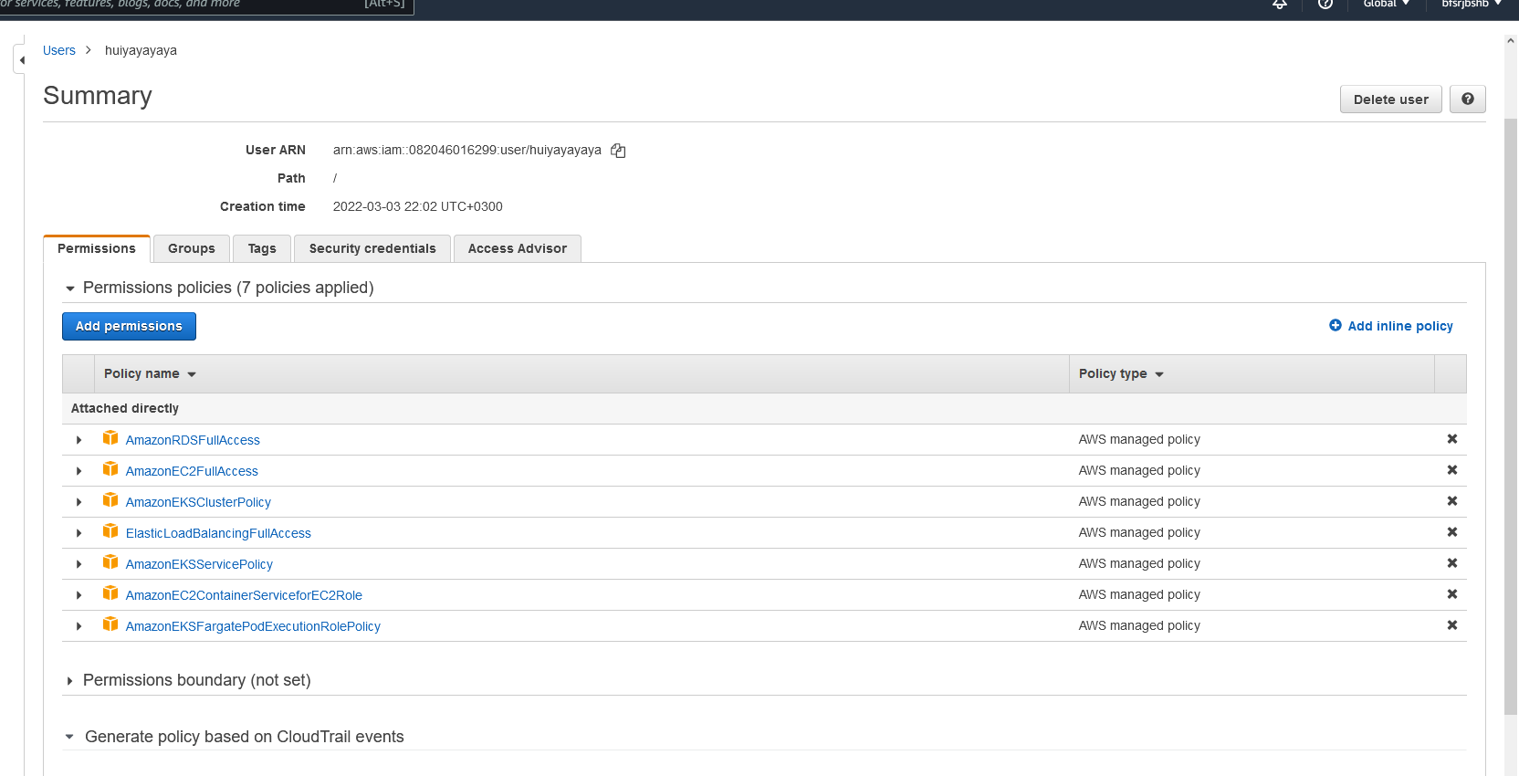
IAM

Slide 4
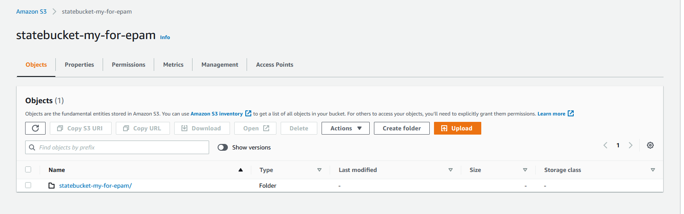
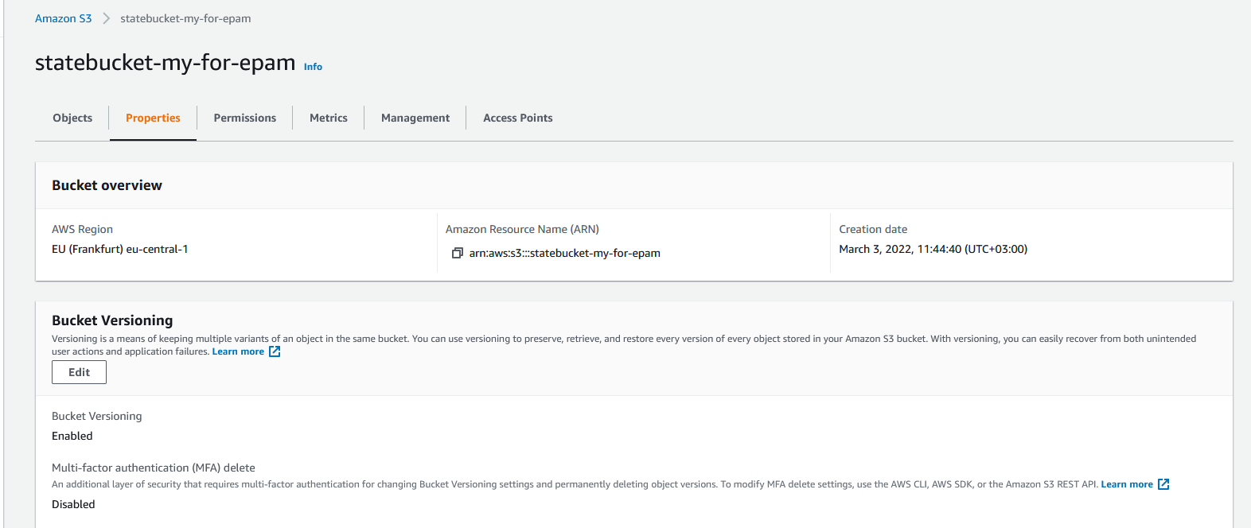
S3

Slide 5
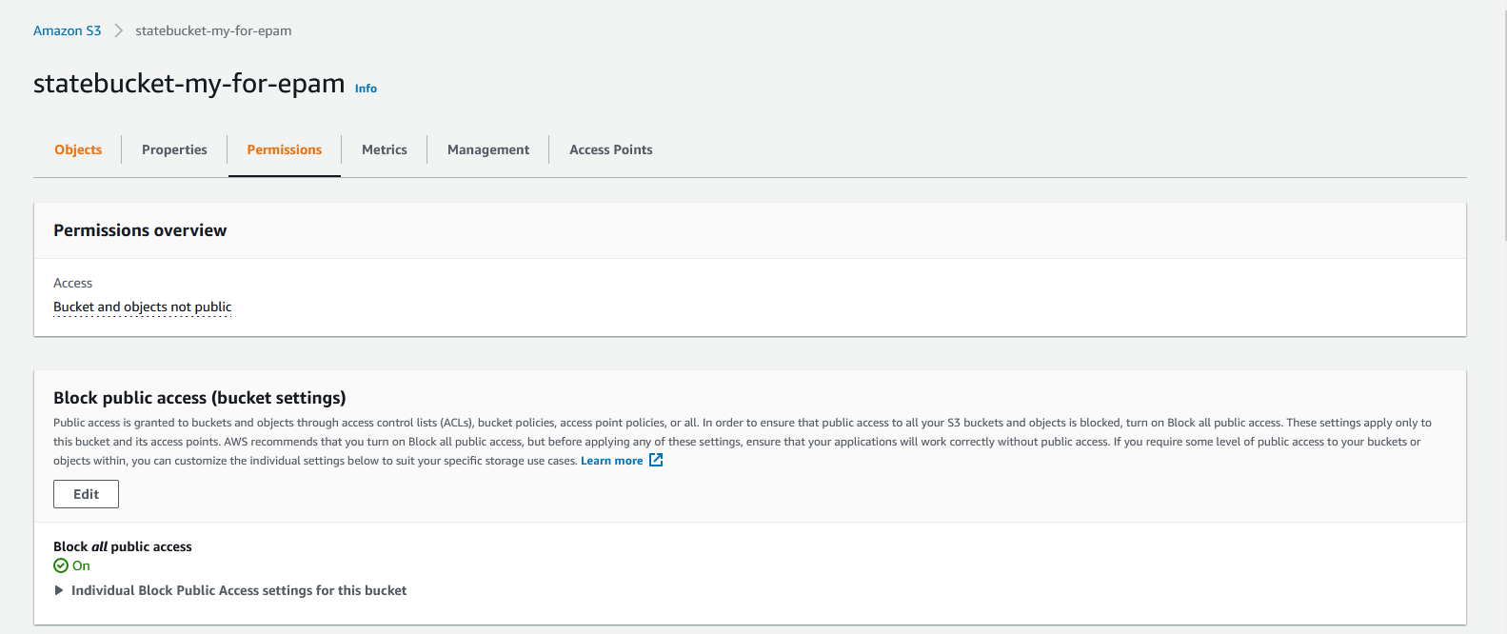
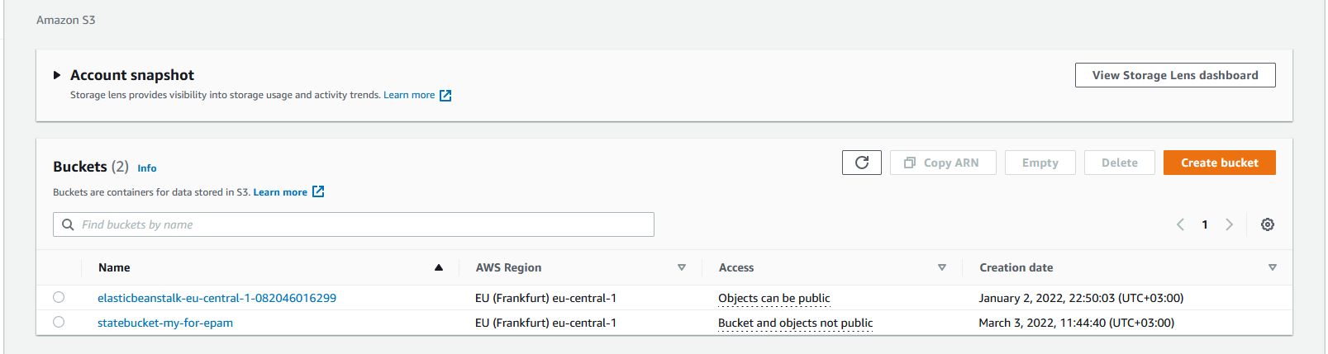
S3

Slide 6
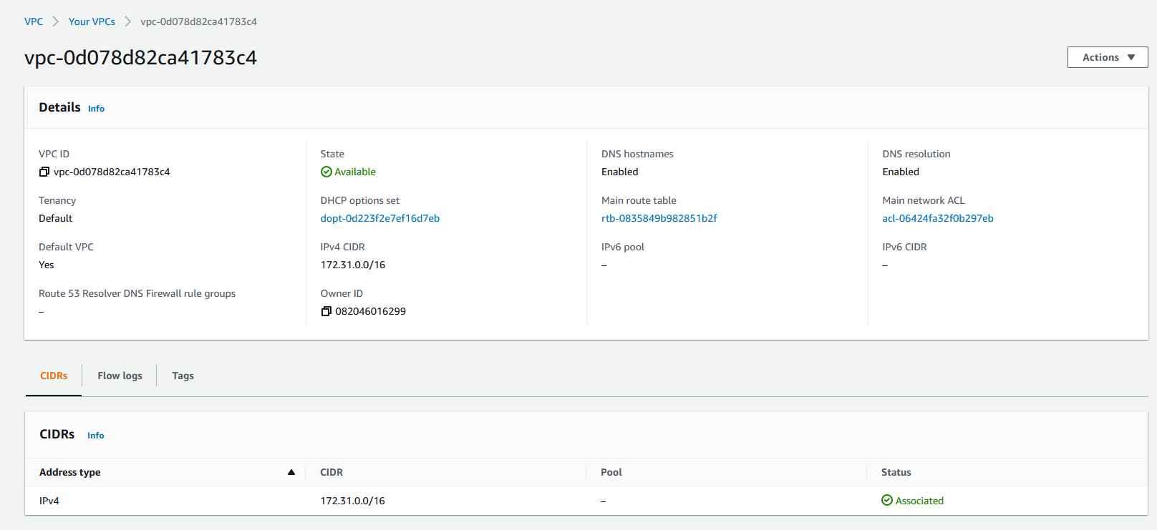
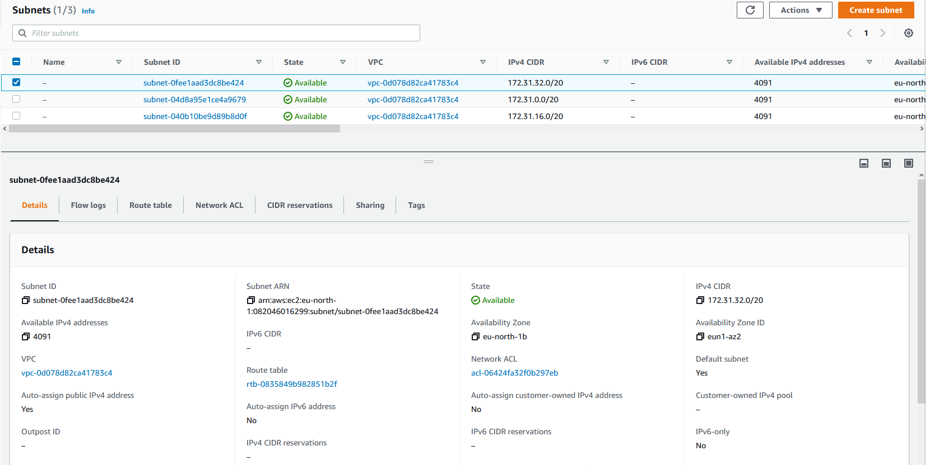
VPS
Subnet

Slide 7
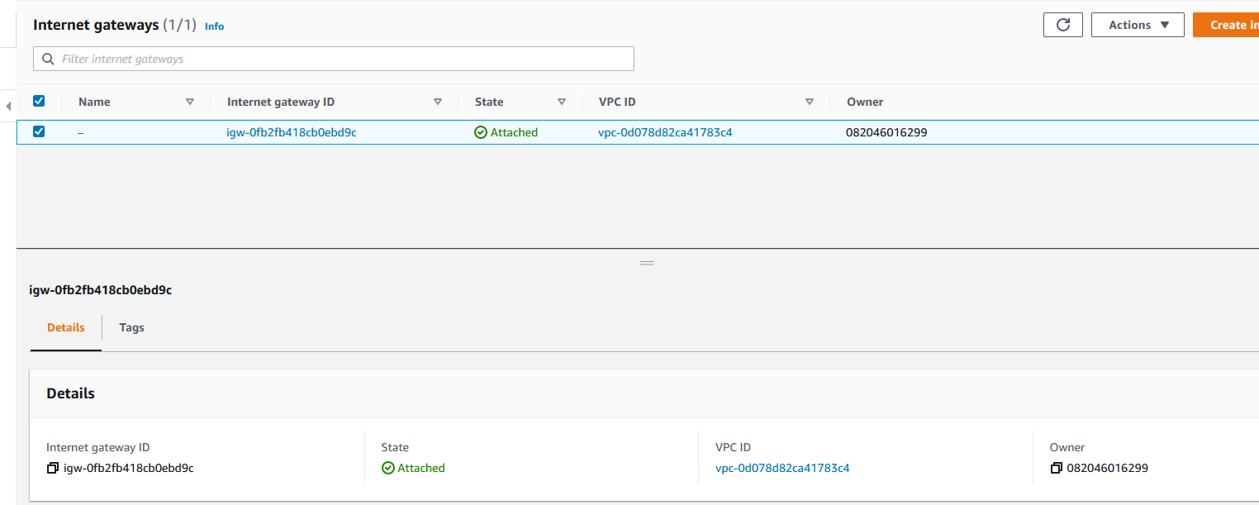
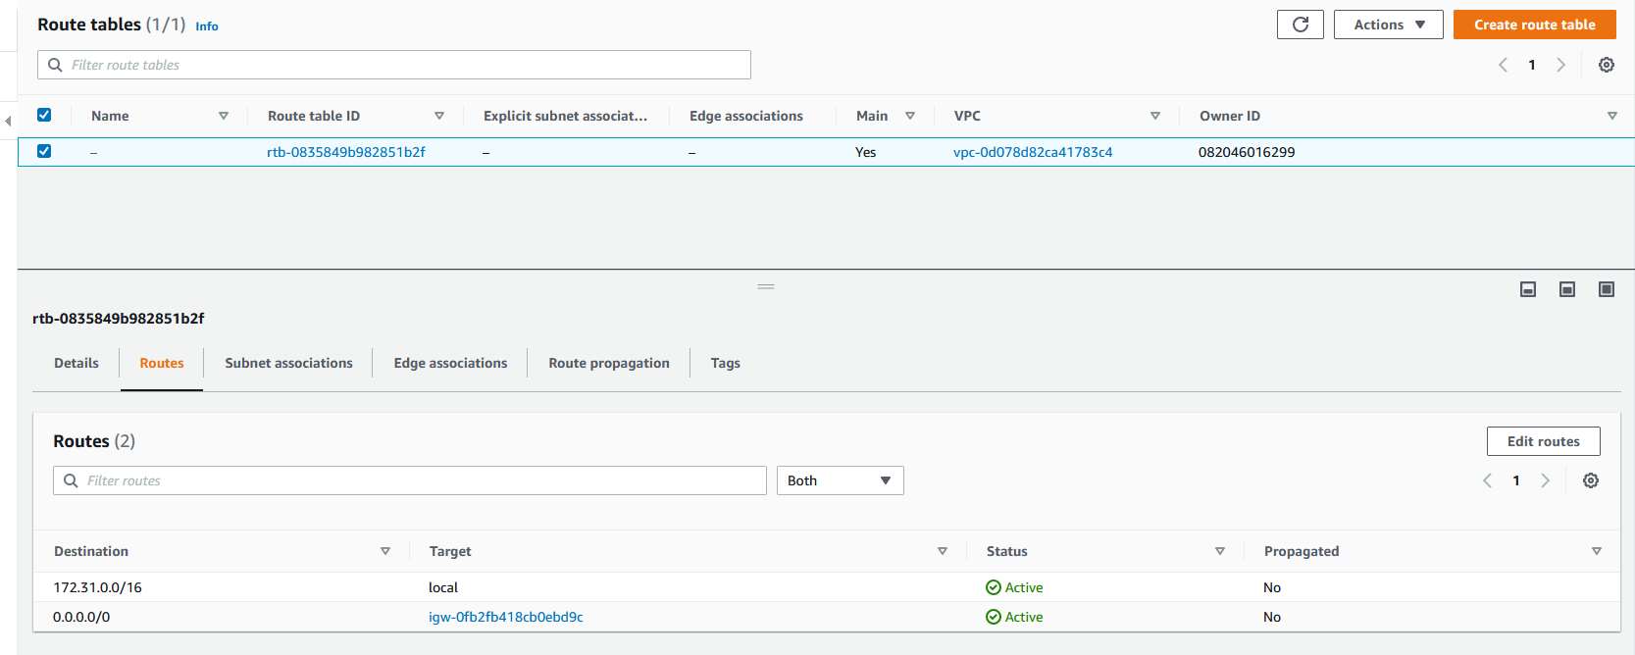
IGW
Route

Slide 8
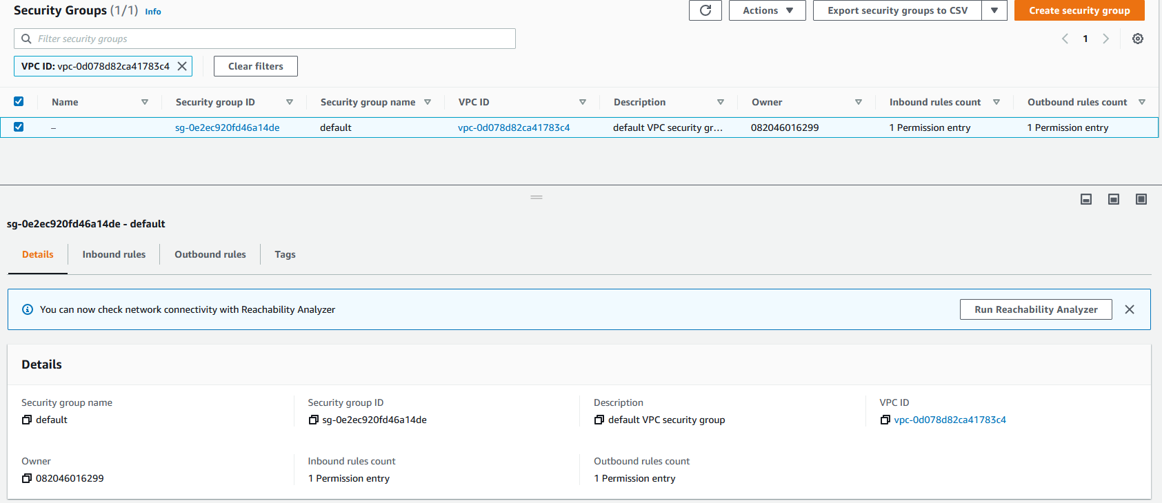
Security Group - VPC

Slide 9
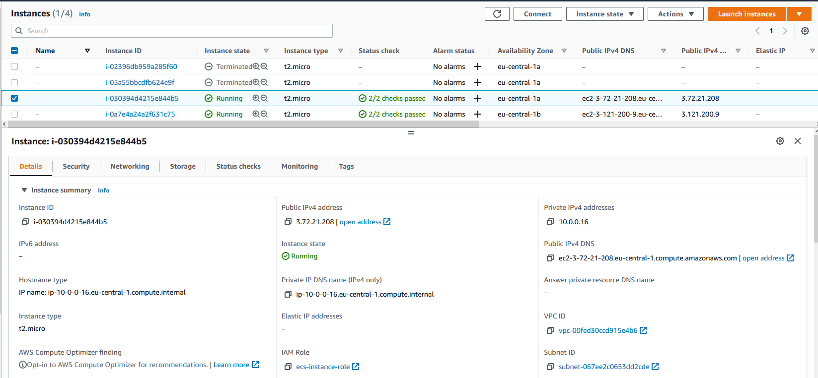
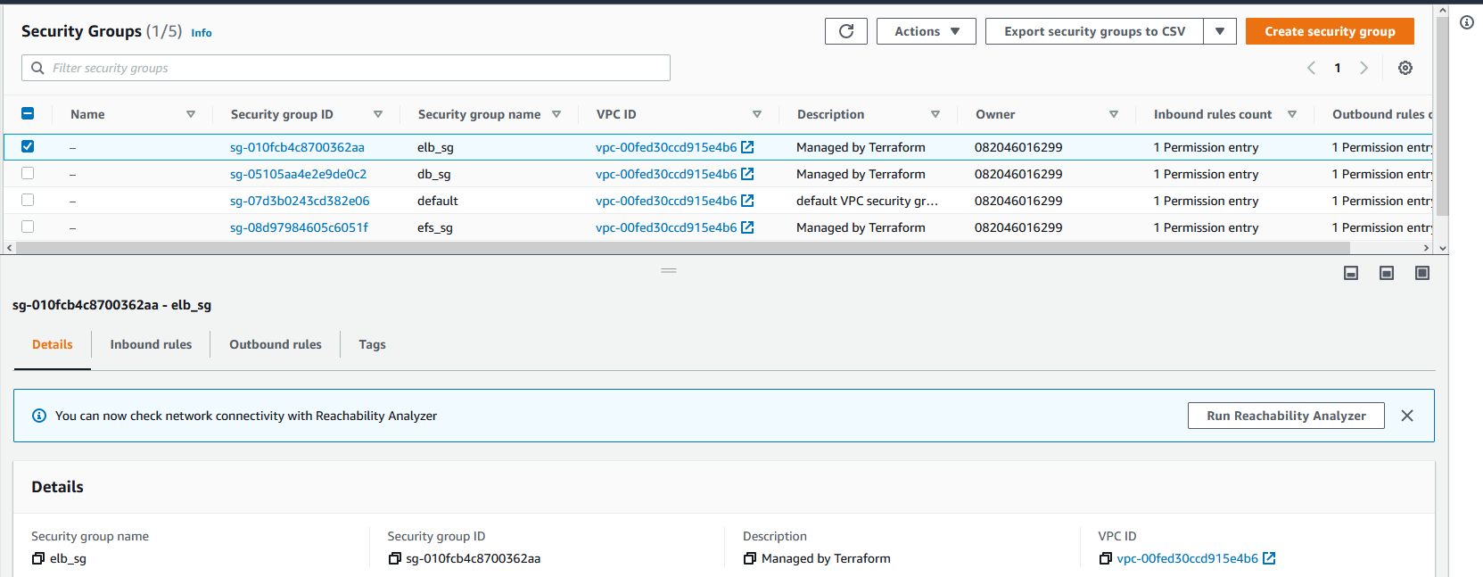
EC2 instances
EC2 SGs

Slide 10
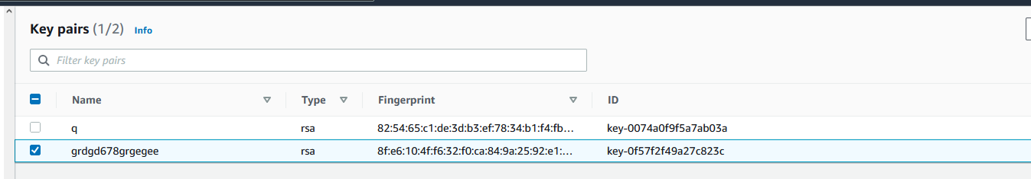
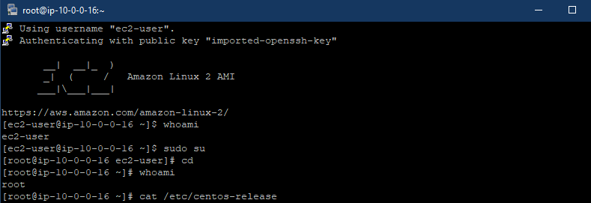
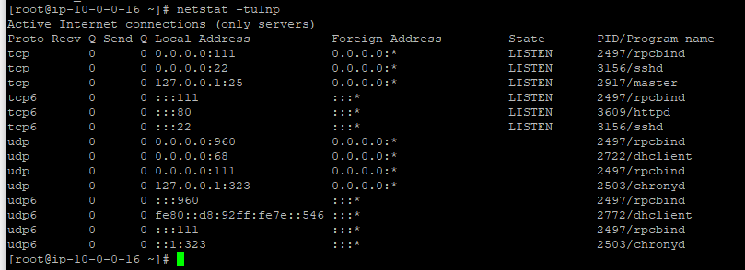
EC2 keypair
Instance login
services

Slide 11
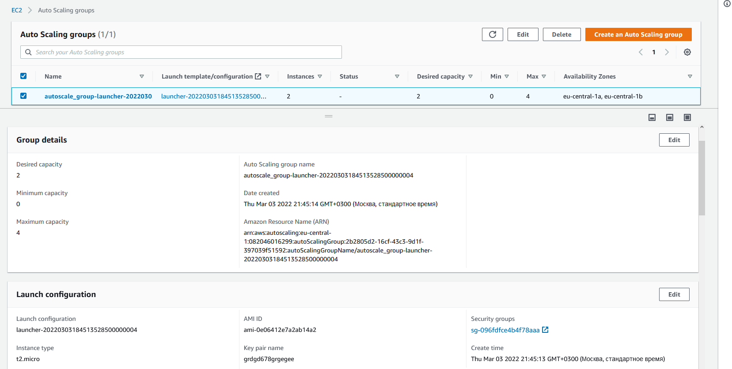
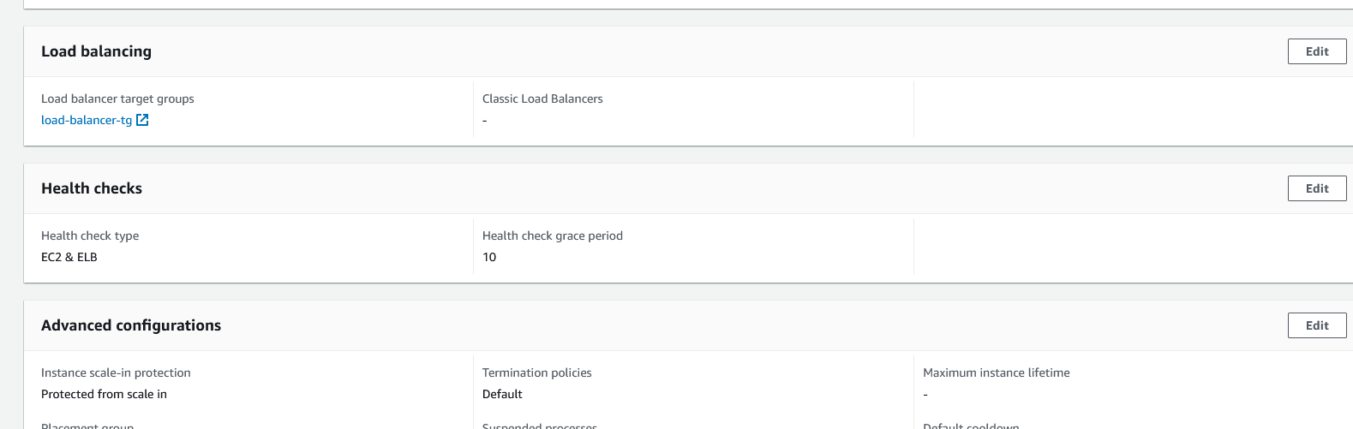
EC2 ASG

Slide 12
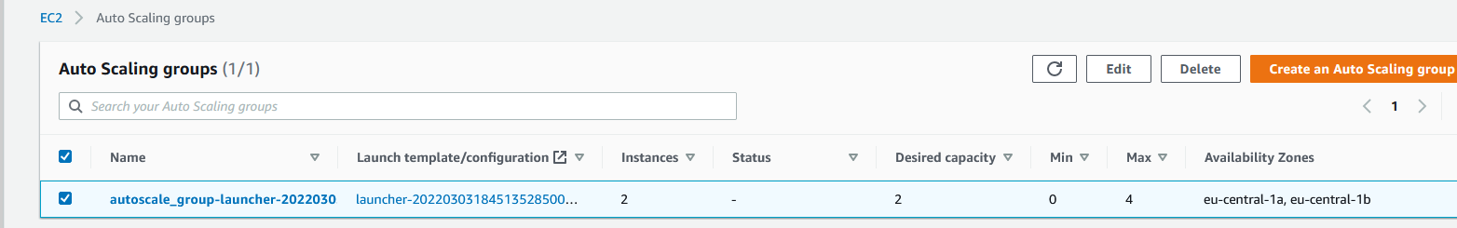
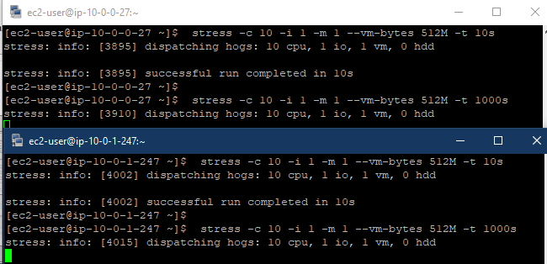
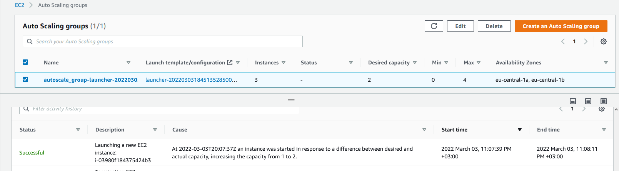
1
2
3
4,5
EC2 ASG
We have 2 instances
Start stress test
Wait check period, asg created
3rd instance
4. Stop stress test
5 ASG returned to minimal
capacity 2 instance

Slide 13
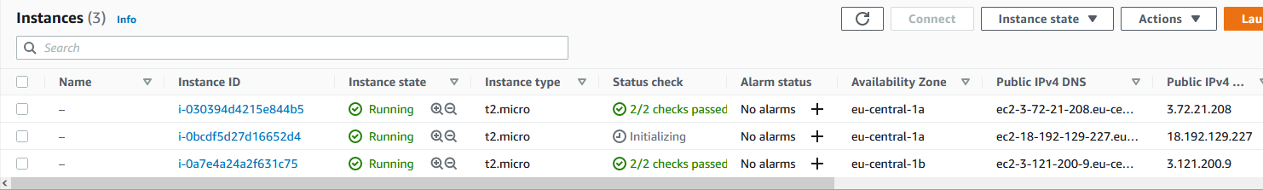
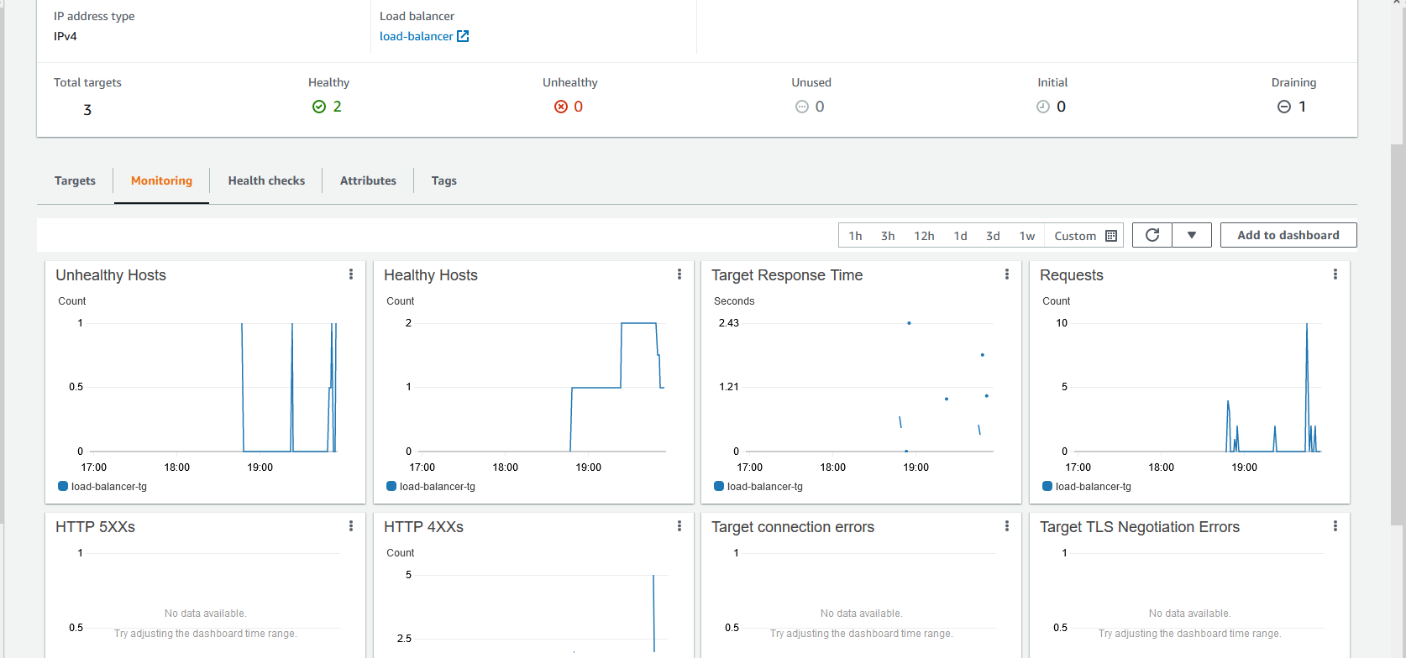
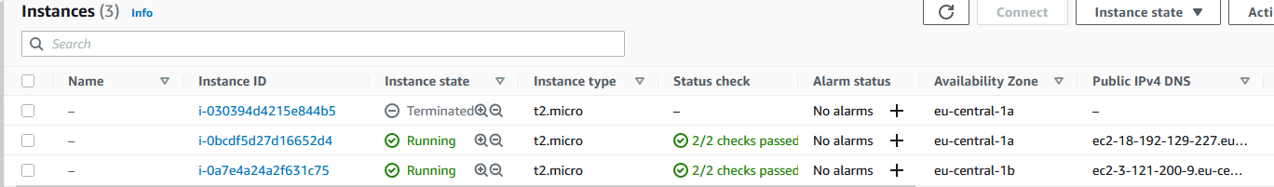
1
2
3
4
EC2 Load balancer
Stop httpd service on one instance
Wait health check period
LB created 3rd instance
Terminating not working instance

Slide 14
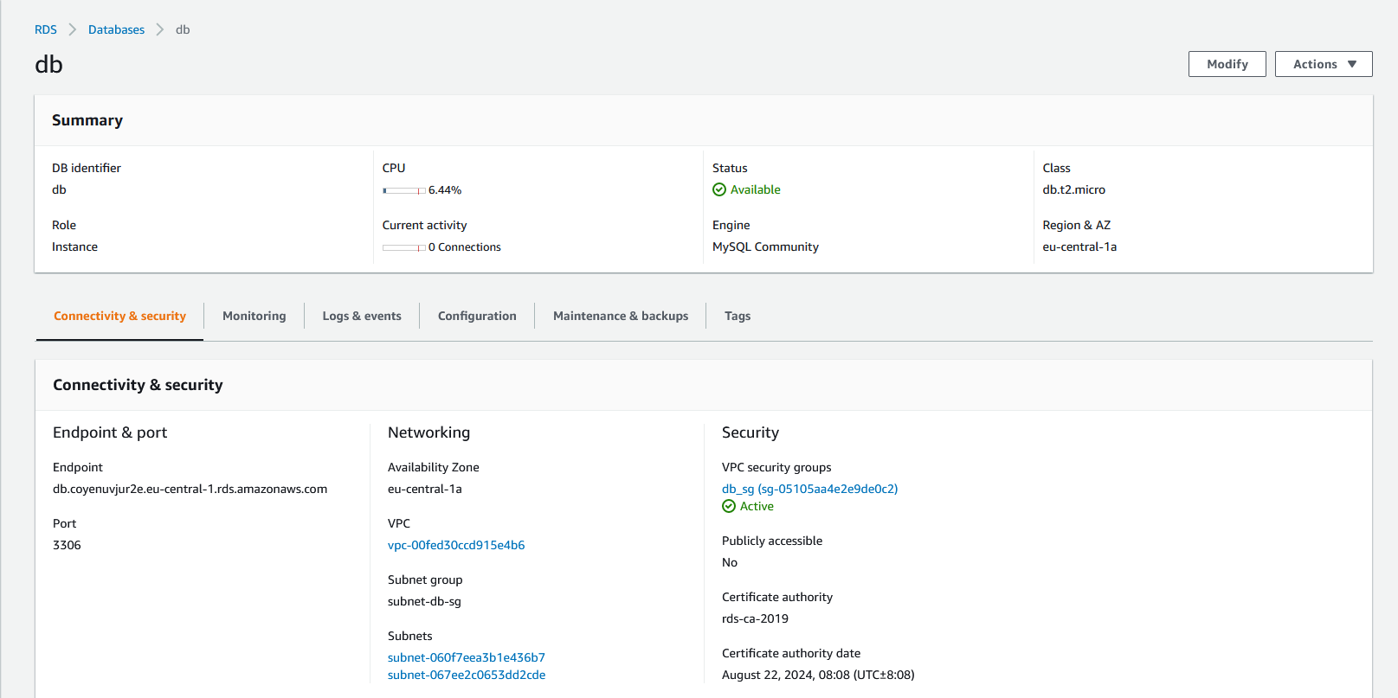
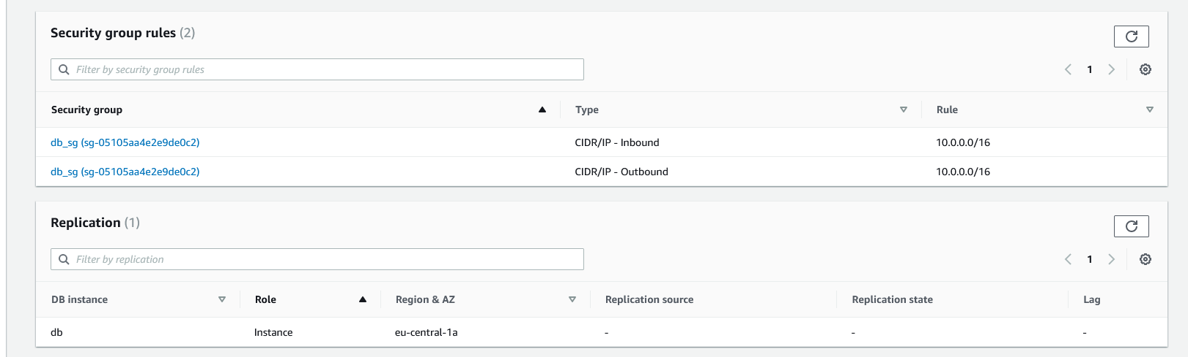
Database
RDS
Security group

Slide 15
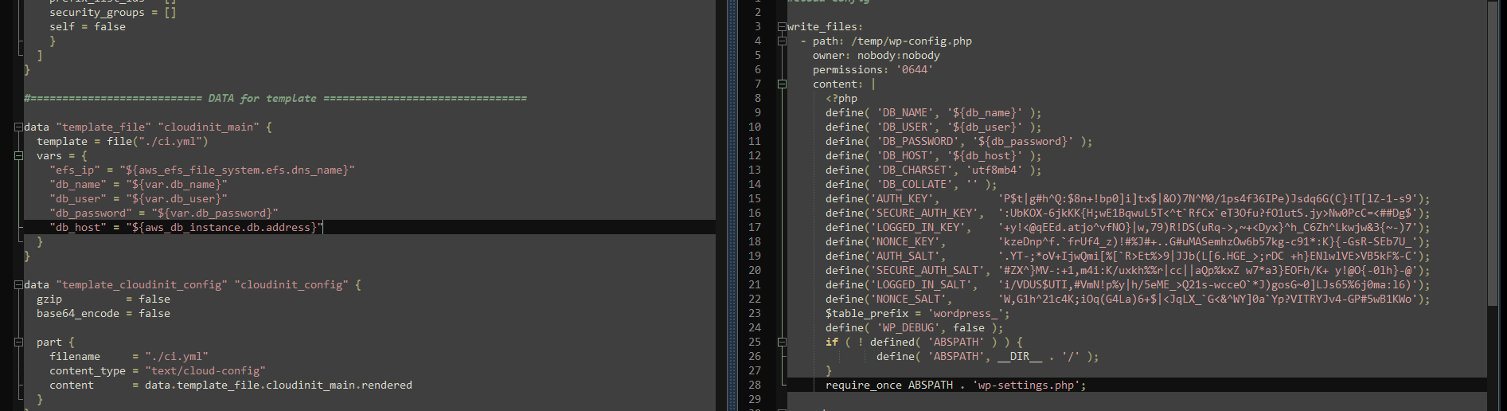
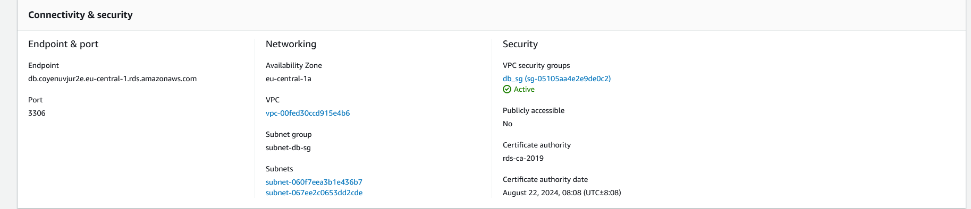
Database
RDS
Terraforms output aws_db_instance.db.address give host address to cloud-init and its installing Wordpress

